Slide 1
G440/540 Terrestrial Ecosystem Modeling Vegetation Processes in TEMs
Instructor: Dr Natasha MacBean

Slide 2
Overview
Plant functional types
Leaf properties: Leaf area index; leaf angle distribution; leaf mass per area
Phenology (leaf seasonal cycles)
Big leaf vs canopy models and radiative transfer (briefly)
Static vegetation: deriving PFT maps from satellite LC maps
Dynamic vegetation: climate envelopes
Dynamic vegetation: vegetation demographic models (briefly)

Slide 3
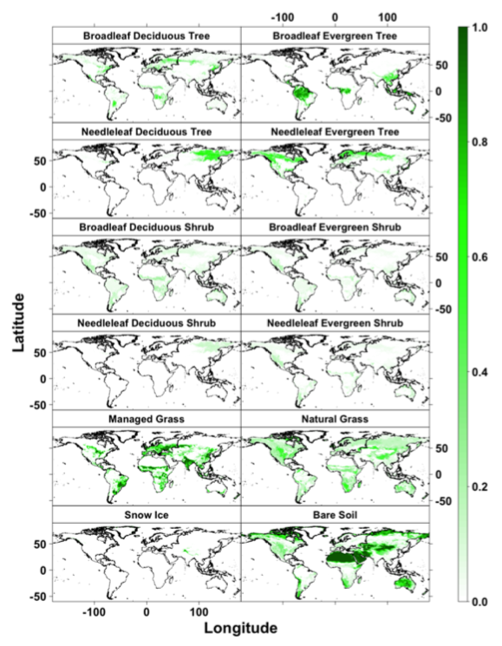
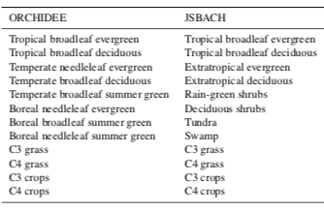
Plant Functional Types
“Groups of plant species that share similar structural, phenological, and physiological traits, and can be further distinguished by climate zone” (Poulter et al., 2015, GMD)
Model parameters often defined per PFT (except for soil properties etc)
Bit more background to PFTs: p302 Ecological Climatology: Bonan (2016)

Slide 4
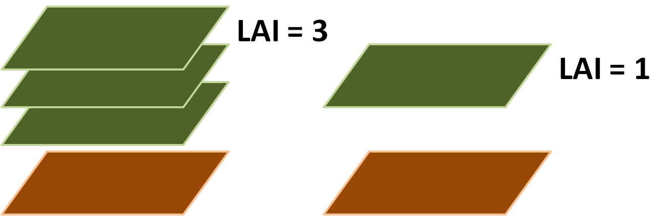
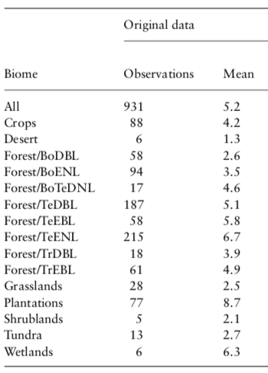
Leaf area index (LAI)
Way to quantify leaf area
LAI = projected (one-sided) area of leaf per unit area of ground
Units m³m⁻³
Easier to estimate for “flat plate” leaves than needles
Important for:
Photosynthesis
Energy balance
Water fluxes
Surface roughness
Asner et al. (2003)

Slide 5
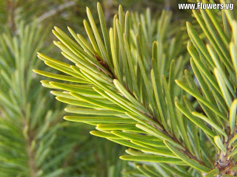
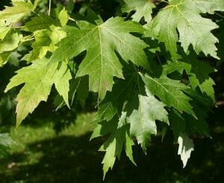
PFT dependent leaf properties
Leaf angle distribution:
Affects radiation transmission through canopy
Important for energy fluxes, radiation budget → especially for multi-layer canopy and comparing to satellite data
Leaf mass per area:
Biomass needed to support a given unit of leaf area
Important for physiology and allocating C assimilated by photosynthesis to leaves
Inverse of specific leaf area (SLA): one-sided area of leaf divided by its dry mass

Slide 6
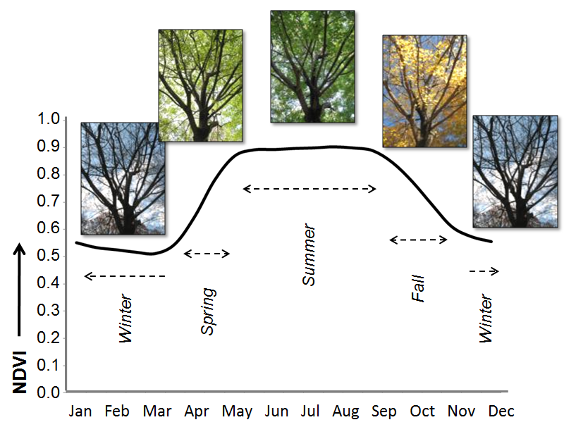
Phenology
Seasonal cycle of leaves:
Leaf onset or “flush”
Leaf turnover
Leaf senescence
Mostly evergreen, summergreen (seasonal deciduous) or raingreen (drought deciduous) plant strategies
Also perennial vs annual species (not always included in models)
Governs start and end of CO₂ uptake
Also controls change in Bowen Ratio (more transpiration)
Changes radiation balance and roughness
Vulnerability of plants to climate change: lots of evidence that spring is earlier

Slide 7
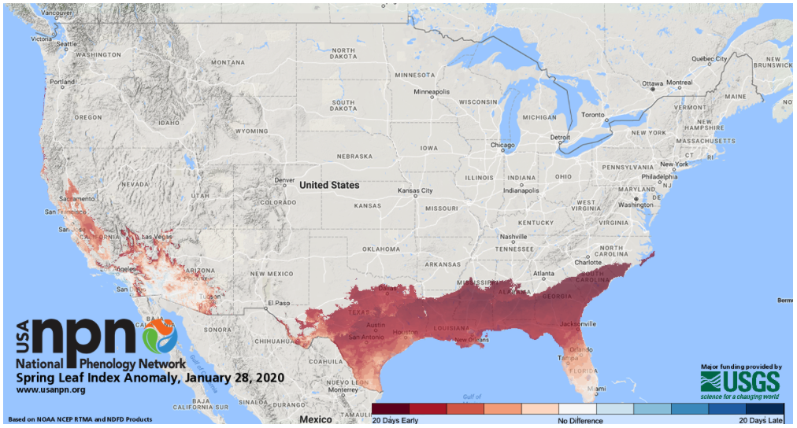
National Phenology Network
https://www.usanpn.org/news/spring

Slide 8
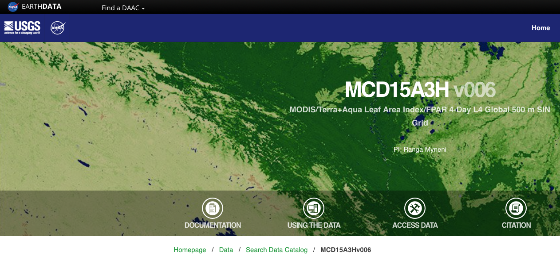
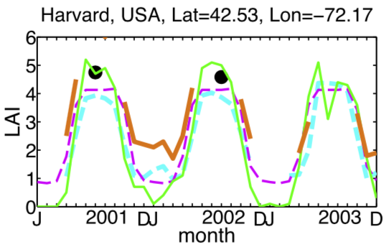
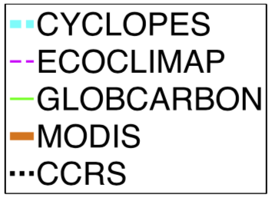
Ways to represent phenology in models
1) Can be prescribed (i.e. an input) using satellite data
Phenological timeseries from satellite LAI or NDVI data; OR
Phenology dates: leaf out, leaf fall (start of season; end of season) derived from these data
https://lpdaac.usgs.gov/products/mcd15a3hv006/
BUT not prognostic
AND differences/uncertainties from different products
NDVI: Normalized Difference Vegetation Index

Slide 9
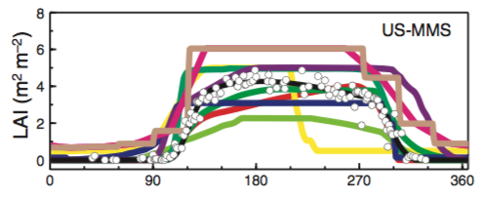
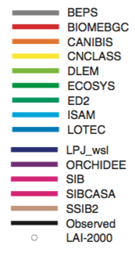
Ways to represent phenology in models
2) Prognostic modeling
Predicted based on climate/growing conditions
Temperature and/or moisture and/or daylength or photoperiod thresholds for leaf onset and senescence
Differs across models → causes uncertainty*
Richardson et al. (2012)
Notes:
Bonan (2019): “precise way to model leaf phenology is highly uncertain”

Slide 10
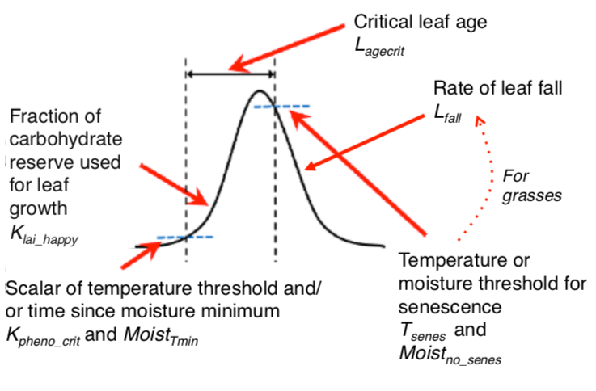
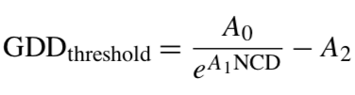
Ways to represent phenology in models: leaf onset
2) Prognostic modeling: Types of models
Growing degree day (GDD) model (Chuine, 2000):
Sums temperatures above a given temperature threshold, T₀ (for example 0 ◦ C), starting at a given date (for example the first of January in the Northern Hemisphere).
Onset of leaves starts when the GDD reaches a plant/PFT-specific threshold
Variations on this theme:
Number of chilling days (NCD) → ”chilling requirement needed”
MacBean et al. (2015)
MacBean et al. (2015): Appendix A
Notes:
In ORCHIDEE, T0 is −5 ◦C, and the GDD sum is calculated from the beginning of the dormancy period, which starts when the leaves were lost or when GPP decreased below a certain threshold.
“chilling requirement”: i.e. their physiology requires cold temperatures to trigger the mechanism that will allow budburst to occur (e.g. Orlandi et al., 2004). This ensures that the dormancy has been broken after a required cold period, and thus prevents a too-early awakening. The Number of Chilling Days (NCD) GDD model initiates leaf onset earlier with an increase in the number of chilling days, defined as a day with a daily mean air temperature below a PFT-dependent threshold accumulated after a given starting date
NCD_GDD model used for temperate and boreal broadleaved deciduous trees in ORCHIDEE

Slide 11
Ways to represent phenology in models: leaf onset
2) Prognostic modeling: Types of models
Number of Growing Days (NGD):
Days with a mean daily temperature above the threshold temperature, T0 (−5 ◦C), has exceeded a PFT-dependent threshold (NGD_{threshold}).
NGD is calculated from the beginning of the dormancy period.
MacBean et al. (2015)
MacBean et al. (2015): Appendix A
Notes:
In ORCHIDEE the NGD model is for arctic and boreal ecosystems

Slide 12
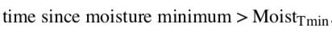
Ways to represent phenology in models: leaf onset
2) Prognostic modeling: Types of models
Moisture thresholds:
E.g. moisture minimum oc- curred a sufficiently long time ago, as specified by a PFT- dependent threshold parameter (Moist_{Tmin})
OR moisture amount greater than a PFT-specific threshold
Much simpler…
Less well studied than temperature thresholds
Grasses usually a combination of temperature and moisture
MacBean et al. (2015)
MacBean et al. (2015): Appendix A
Notes:
In ORCHIDEE the NGD model is for arctic and boreal ecosystems

Slide 13
Ways to represent phenology in models: leaf onset
2) Prognostic modeling: Types of models
Daylength or photoperiod thresholds:
Some species appear to have evolved physiological cues to wait until there’s enough radiation
Notes:
Photoperiod/daylength not included in ORCHIDEE

Slide 14
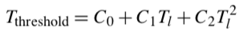
Ways to represent phenology in models: leaf senescence
2) Prognostic modeling: Types of models
PFTs controlled by temperature → senescence occurs when weekly/monthly air temperature falls below a threshold
Threshold defined by long-term mean:
PFTs controlled by moisture: when daily moisture falls below a threshold Moist_{senes}
Senescence models less well developed than leaf onset
Leaf age also governs timing of senescence
Notes:
In ORCHIDEE the NGD model is for arctic and boreal ecosystems

Slide 15
Ways to represent phenology in models
Note: rate of leaf growth and fall also parameters in model
Parameters are often not observable and are designed to fit model to observations.
Notes:
In ORCHIDEE the NGD model is for arctic and boreal ecosystems

Slide 16
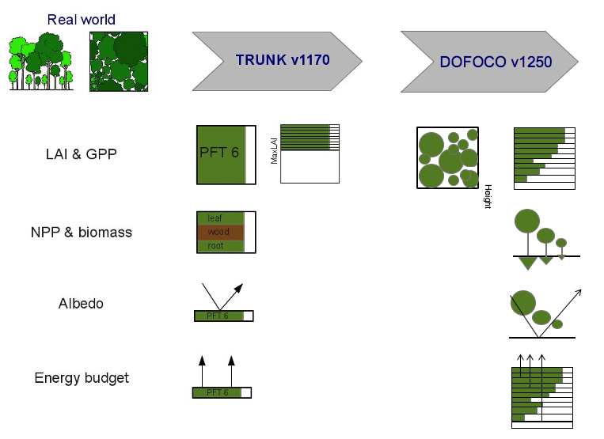
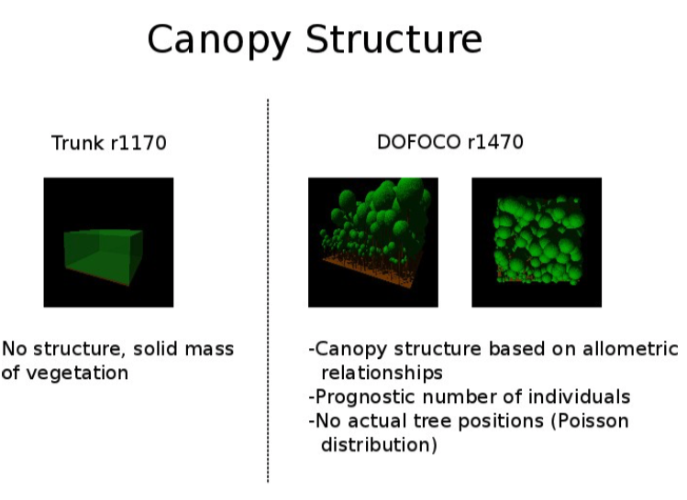
Canopy structure and radiative transfer*
Big Leaf
VS
Gap model & multi-layer canopy
Radiative transfer/energy budget/albedo
Energy fluxes/microclimate → C/W cycles
Chapters 14 (radiative transfer), 15 (plant canopies) and part 19 (forest gap models) of textbook

Slide 17
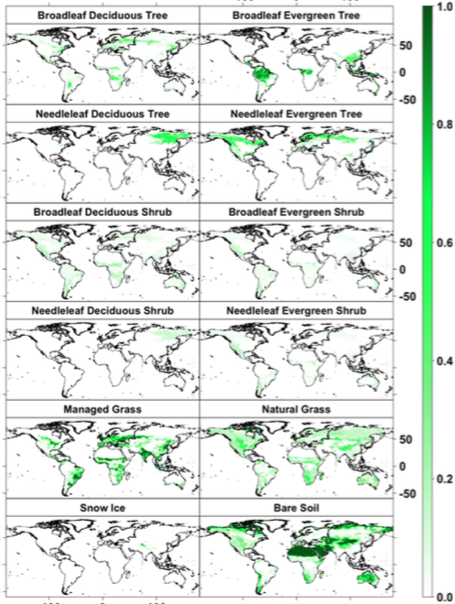
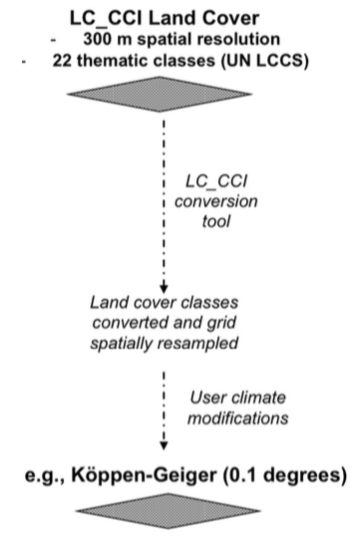
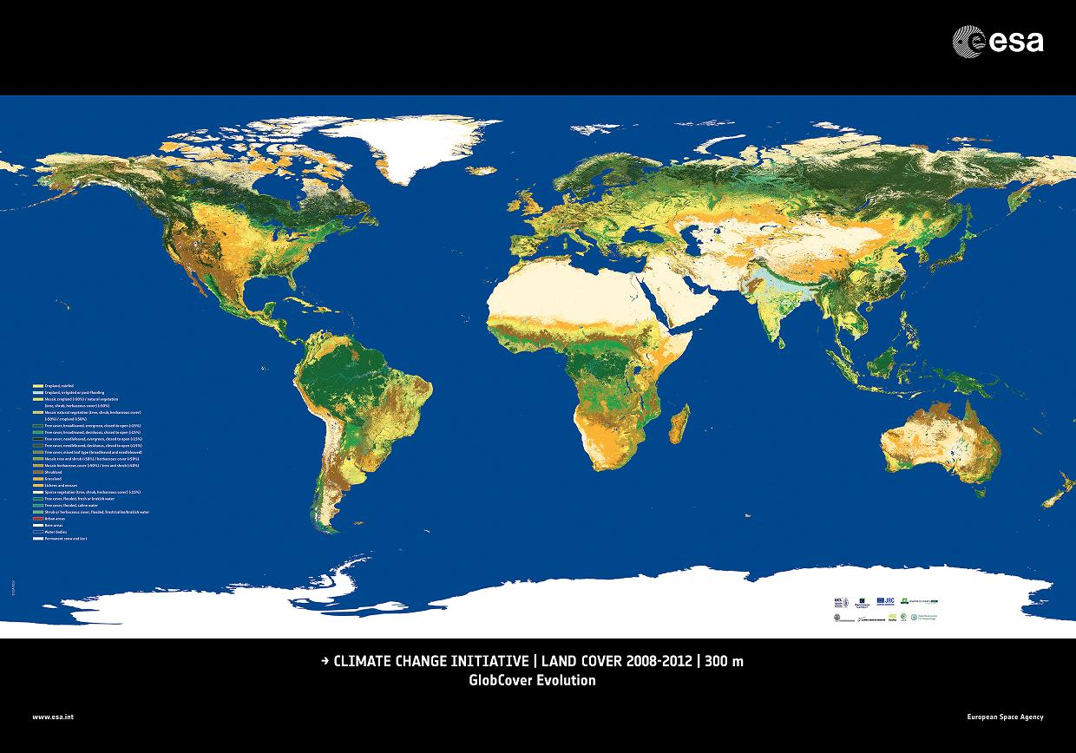
Static vegetation simulations
Maps of vegetation distribution (and soil properties) used to initialize LSMs
Often derive PFT maps from land cover data
Model PFTs
ESA CCI Land Cover Map
Rules for mapping LC class to PFT
Poulter et al. (2015)

Slide 18
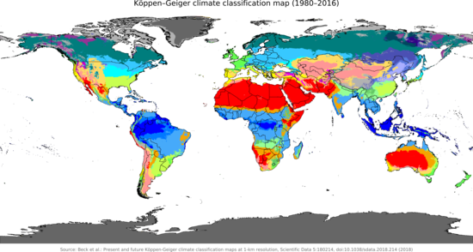
Static vegetation simulations
ESA CCI Land Cover Map Legend
Rules for mapping LC class to PFT
Model PFTs
Including for the climate…
Poulter et al. (2015)

Slide 19
Static vegetation simulations
Uncertainties arise from this procedure…
Uncertainty in land cover mapping algorithm
Uncertainty in conversion (“cross-walking”) table between LC and PFT classes
Uncertainty in climate classification used to split into “tropical”, “temperate” and “boreal” or C3 / C4 grass split
(1)
(2)
(3)
(2) LC-to-PFT conversion table
Hartley et al. (2017)

Slide 20
Static vegetation simulations
Uncertainties arise from this procedure…
Rules for mapping LC class to PFT
Hartley et al. (2017): Uncertainty due to PFT mapping could be equivalent or higher than inter-model spread (depending on variable)

Slide 21
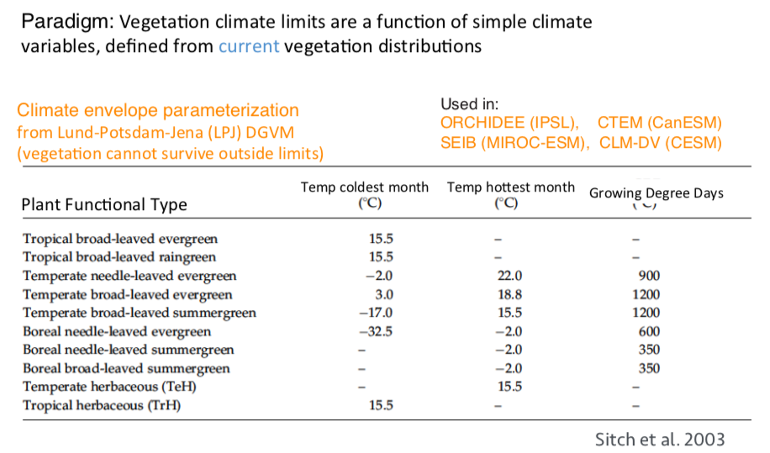
Dynamic global vegetation model simulations
1st generation DGVMs (1990s and 2000s): simple climate envelope modeling
From: R Fisher

Slide 22
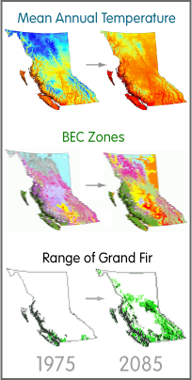
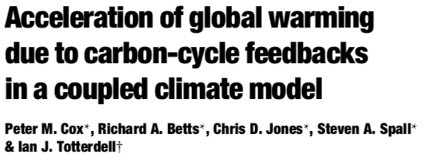
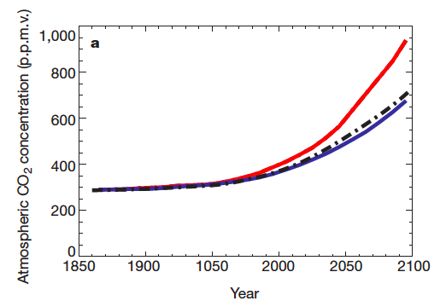
Dynamic vegetation simulations
Also used for species distribution projections and resource management
Problems:
Sudden shifts in vegetation → Amazon dieback problem of Cox et al (2000)
Doesn’t allow for species succession
Only based on climate (no dynamic changes after disturbance etc)
https://cfcg.forestry.ubc.ca/projects/climate-data/climatebc-and-bioclimatic-envelope-modelling/

Slide 23
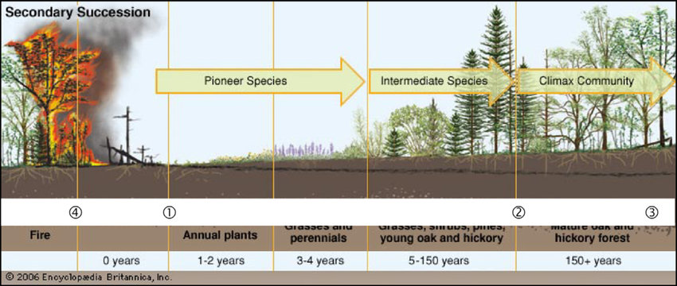
Vegetation demography models*
2nd generation (2010s) → move towards ”demography” models: take into account populations of species and the canopy structural changes (horizontally and vertically) over time
More mechanistic way to model dynamic vegetation shifts due to climate, disturbance etc.
Demographic processes: canopy gap formation, competition for light, species competition, recovery
No sudden shifts…improved representation of plant diversity (more resilient ecosystems?)
EstablishmentGrowth
Competition
Co-existence
Exclusion
Recruitment
Mortality
23

Slide 24
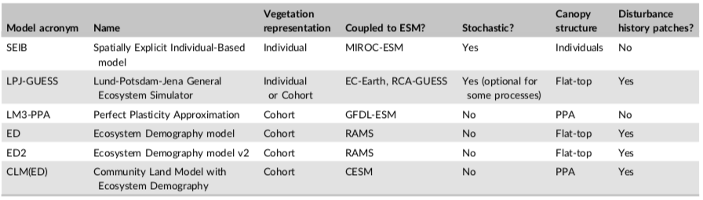
Vegetation demography models*
Different ways to model populations of trees etc within a canopy:
Forest gap or “individual” models
Cohorts (groups) of individuals with similar properties (age/time since disturbance, size/height, plant functional type)
Spatial structure allows spatial variability in light; therefore, competition…
Individual models very computationally expensive → prohibitive for global TBMs/ESMs
Cohort-based models allow similar dynamics at reduced computational cost
Fisher et al. (2018)
Notes:
Individual based models have to use stochastic representation of tree heterogeneity within the canopy because they cannot know where all the trees are…

Slide 25
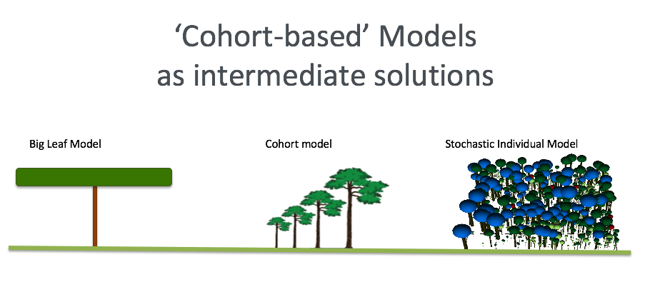
Vegetation demography models*
Allows multi-layer energy scheme
From: R Fisher
Notes:
Individual based models have to use stochastic representation of tree heterogeneity within the canopy because they cannot know where all the trees are…

Slide 26
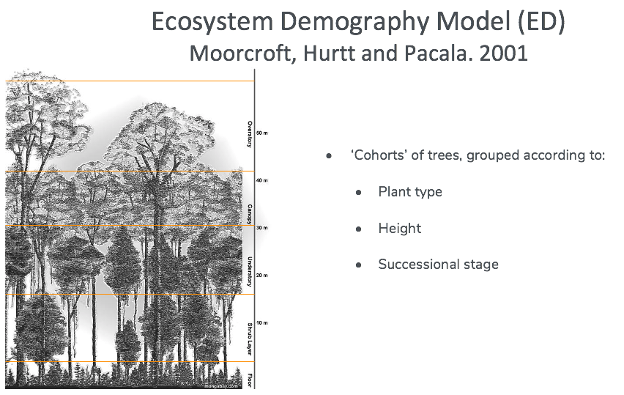
Vegetation demography models*
From: R Fisher
Notes:
Individual based models have to use stochastic representation of tree heterogeneity within the canopy because they cannot know where all the trees are…

Slide 27
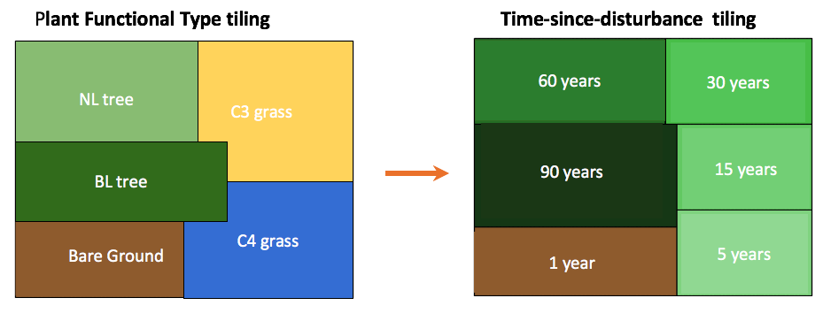
Vegetation demography models*
Vegetation structure in ED
From: R Fisher
Notes:
Individual based models have to use stochastic representation of tree heterogeneity within the canopy because they cannot know where all the trees are…

Slide 28
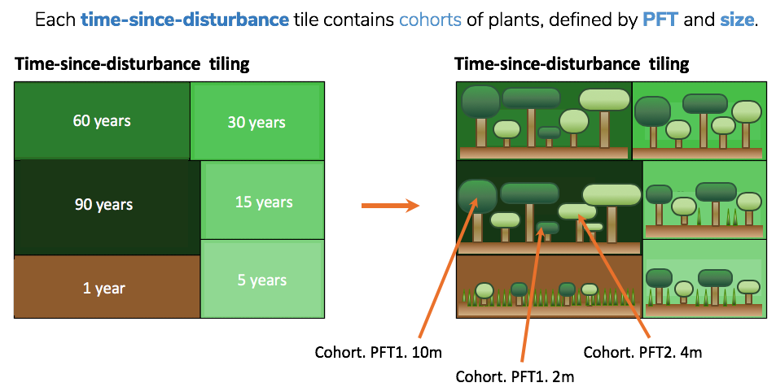
Vegetation demography models*
Vegetation structure in ED
From: R Fisher
Notes:
Individual based models have to use stochastic representation of tree heterogeneity within the canopy because they cannot know where all the trees are…

Slide 29
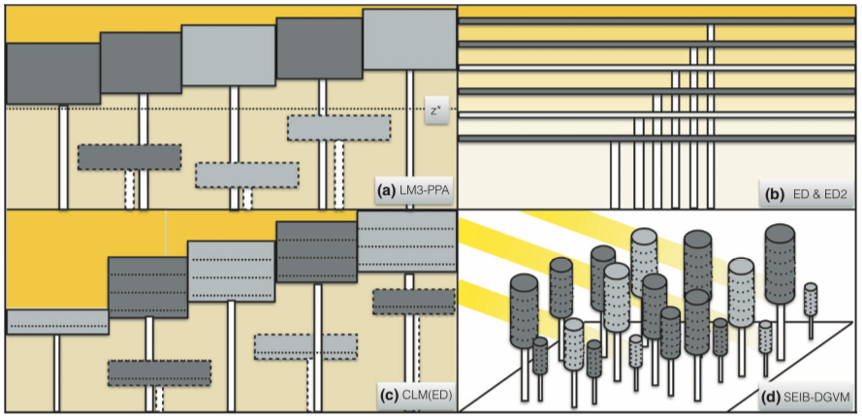
Vegetation demography models*
Still, different ways of representing cohorts in different models!
And different ways of constraining growth…
Fisher et al. (2018)

